Slide 1
Weekly Report
11/7/22
Erin Ingram & Omar Mahmood
NanoBio Systems Lab
Texas A&M University

Slide 2
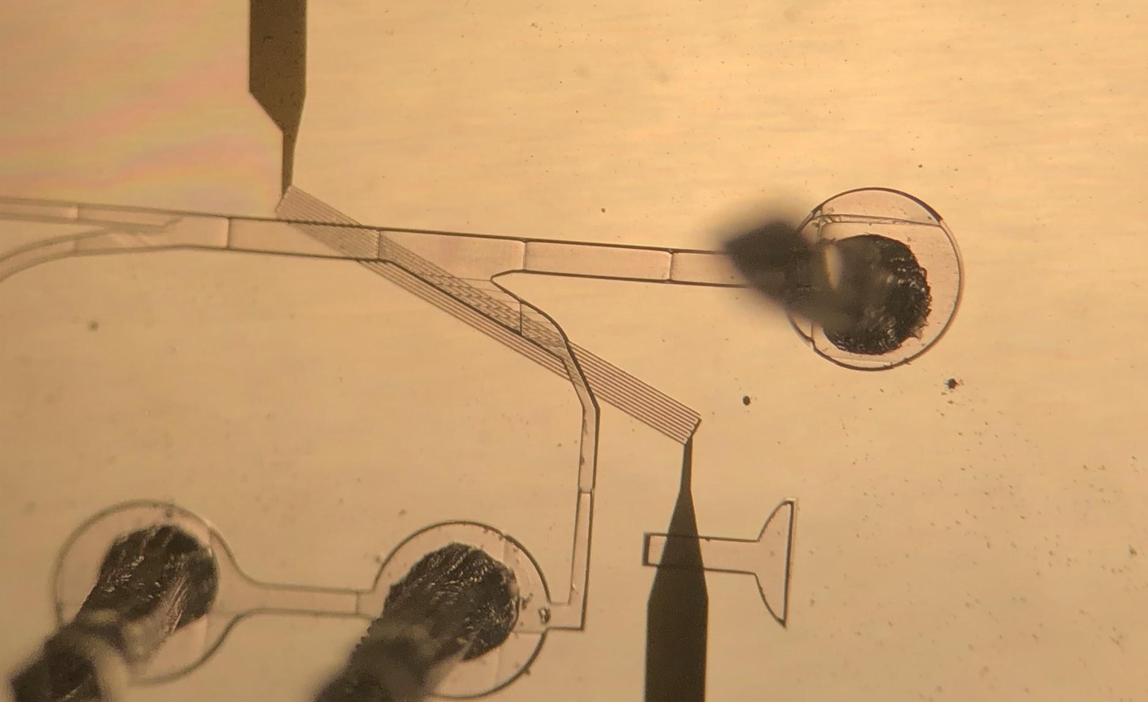
Progress
Bonded PDMS chips to IDE slides using plasma cleaner
Trained on alignment of IDE with physical filtration channel
Fabricated more PDMS copies of high pass filter

Slide 3
Goals for next week
Begin experiments using our device
Test droplet generation
Test filtration of satellite droplets

Slide 4
Thank you for your time!

